Slide 1
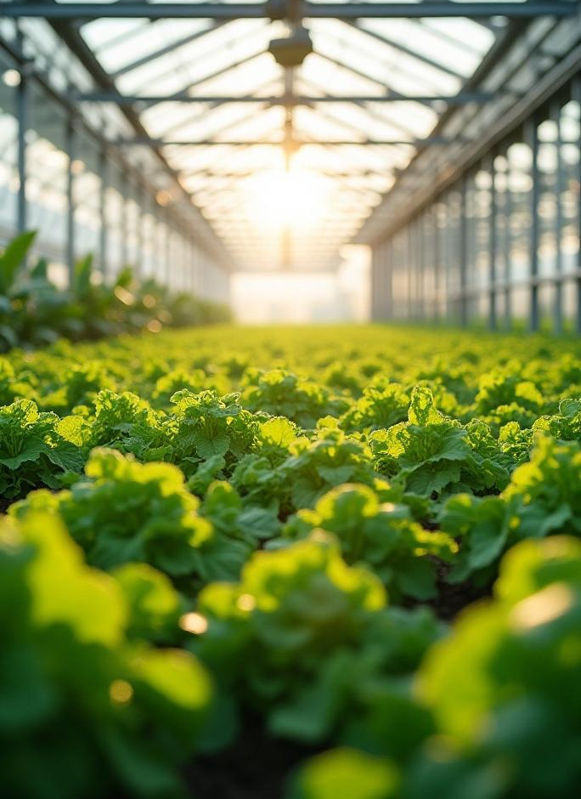

IoT-Based Greenhouse
SANJIVANI UNIVERSITY
School of Engineering & Techonology
………………………………………..
Department of Artificial Intelligence & Data Science
Community Engagement Project
On
---- Presented By ----
Mr. Kartik Phopase (2124UDSM20..)
Mr. Om Kadam (2124UDSM20..)
Mr. Darshan Aher (2124UDSM20..)
Mr. Vedant Jagtap (2124UDSM20..)
Miss.Rutuja (2124UDSM20..)
Under the Guidance of
Prof…………………………….

Slide 2
Content
Introduction
Problem Statement
Problem Statement Solution
Components
Circuit Diagram
Project Dashboard
Software & Tools
Project Model
Model Output
Conclusion

Slide 3
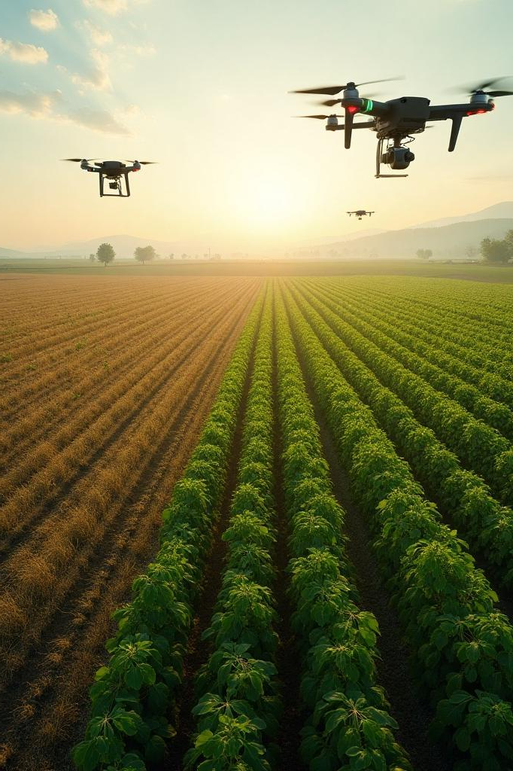
Introduction
Greenhouses provide controlled environments to grow plants, but traditional methods require constant human attention. Improper irrigation, inconsistent temperature, and poor air quality often lead to unhealthy crops and resource wastage. With the rise of IoT, we can automate these processes to maintain ideal conditions around the clock.
Why IoT in Greenhouses?
Real-time monitoring and control
Reduces human labor
Increases crop yield and efficiency
Enables remote access via dashboards or mobile apps

Slide 4
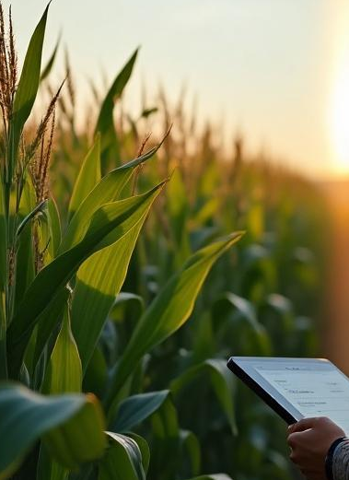
Problem Statement
Manual Monitoring: Requires regular human intervention for temperature, soil moisture, and humidity checks.
Resource Wastage: Overwatering or under-watering due to lack of precise data leads to water and energy wastage.
Poor Air Management: Unchecked CO₂ levels or humidity affect plant growth.
Lack of Data Logging: No historical data to track plant growth patterns or make improvements.

Slide 5
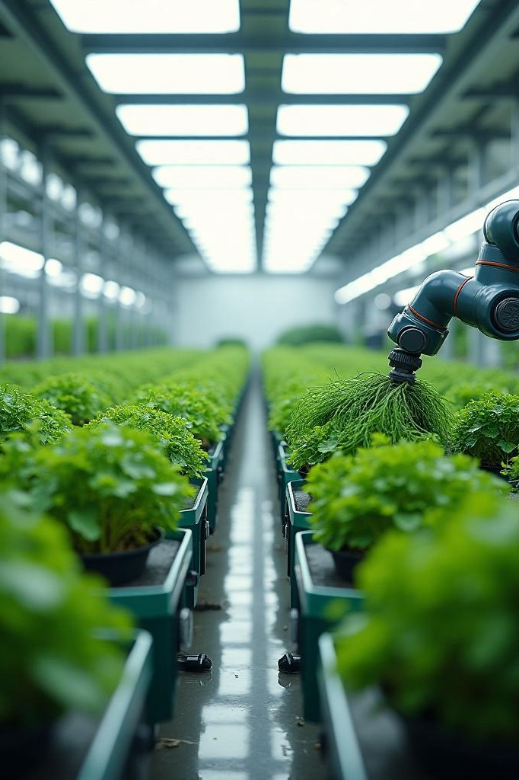
Problem Statement Solution
ESP32-based system connected with various sensors to detect temperature, humidity, soil moisture, light intensity, and air quality.
Real-time data processing to activate actuators like water pump, fan, and lights automatically.
Mobile/Web dashboard for live monitoring and manual control.
Alerts/Notifications for critical environmental changes.
Energy efficiency through intelligent decision-making.

Slide 6
Components
Microcontroller:
ESP32- The core of the system, handling sensor data and automation.
Sensors:
Rain Drop Sensor – Detects rainfall to adjust watering schedules.
Water Sensor – Measures water levels to prevent over/underwatering.
MQ-135 (Air Quality Sensor) – Monitors air pollution and CO₂ levels.
LDR Sensor (Light Dependent Resistor) – Detects light intensity for automated lighting control.
Soil Moisture Sensor – Measures soil moisture levels for irrigation automation.
DHT22 (Temperature & Humidity Sensor) – Monitors greenhouse temperature and humidity.

Slide 7
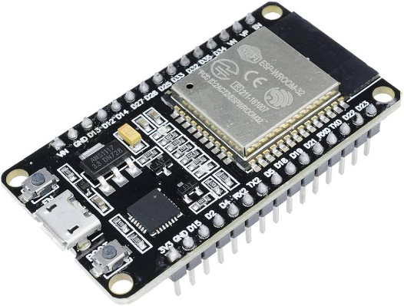
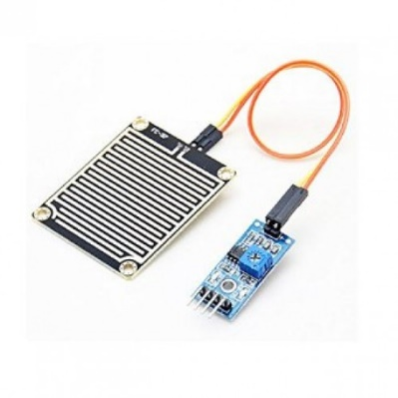
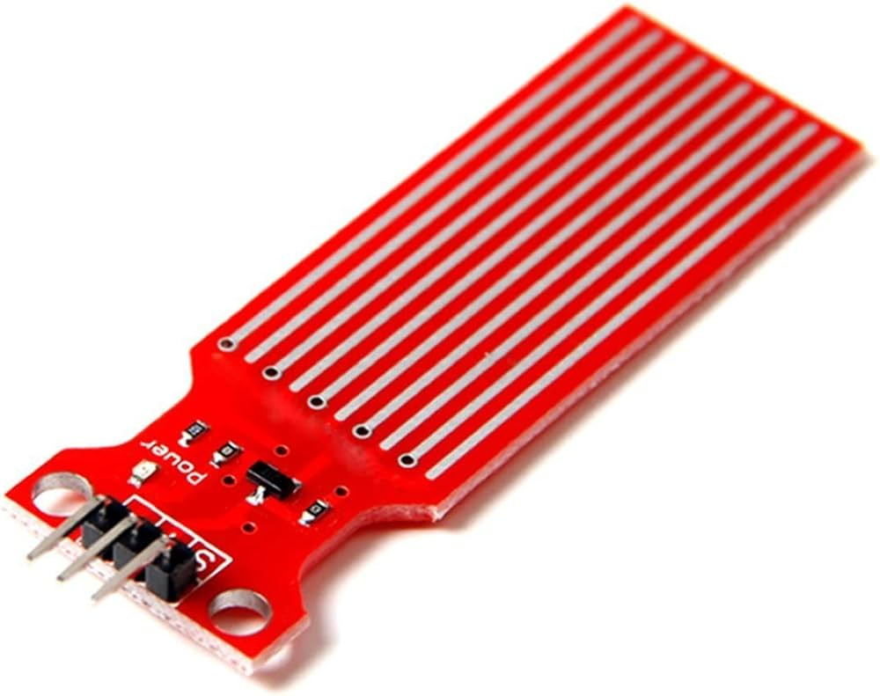
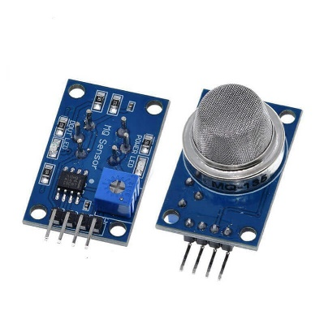
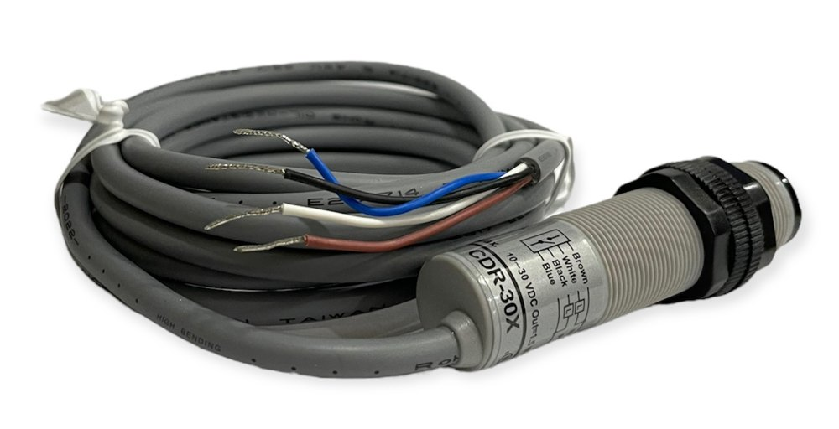
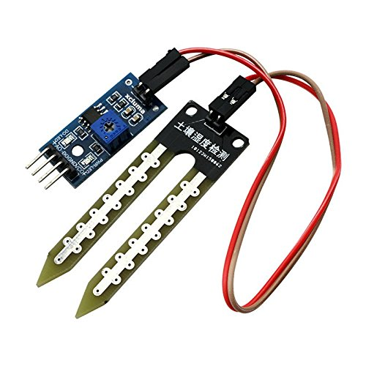
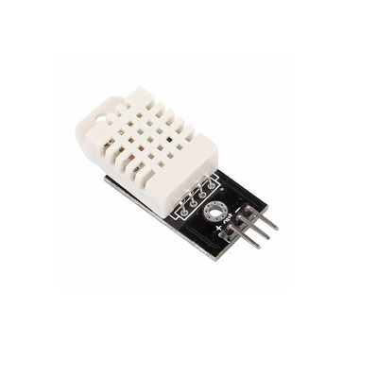
Components
ESP32
Water Sensor
Rain Drop sensor
MQ-135
Soil Moisture Sensor
CDR Sensor
DHT22

Slide 8
Circuit Diagram

Slide 9
Project Dashboard

Slide 10
Software & Tools

Slide 11
Project Model

Slide 12
Model Output

Slide 13
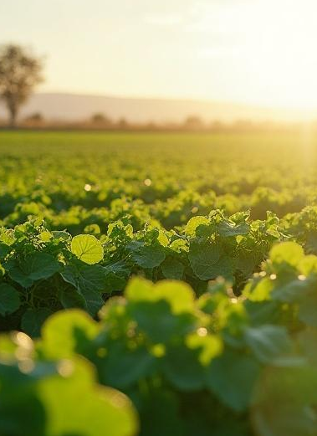
Conclusions
The IoT-Based Greenhouse System effectively automated core greenhouse operations.
Reduced manual work and human error significantly.
Enhanced water and energy efficiency using intelligent decision-making.
Improved plant health and provided scalable solution for modern farming.
Future improvements can include:
AI integration for predictive control.
Solar energy for off-grid usage.
Cloud database for long-term data storage and analytics.
Automated fertilization based on soil quality.

Slide 14
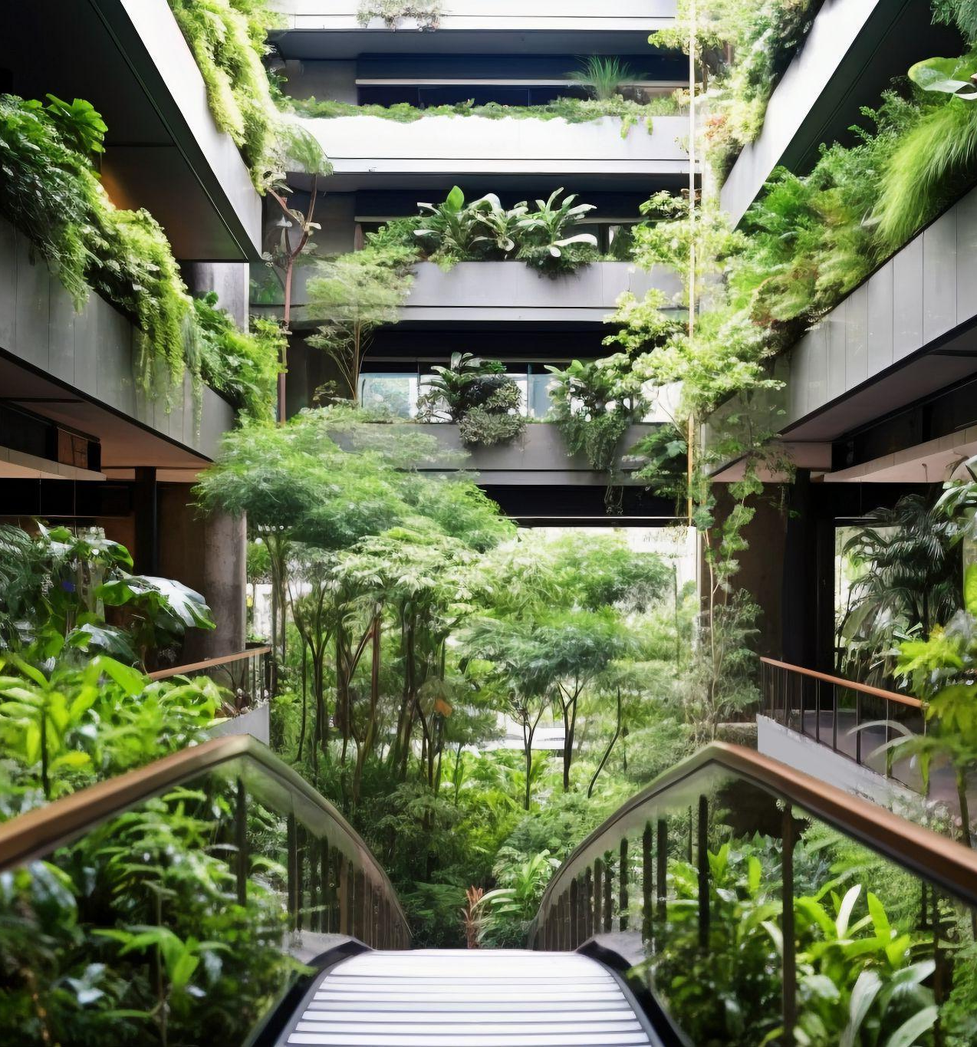
Thank you!
Do you have any questions?
www.yourwebsite.com
↓
CREDITS: This presentation template was created by Slidesgo, and includes icons, infographics & images by Freepik
+91 620 421 838

